Slide 1
CSE 486/586 Distributed Systems Global States
Steve Ko
Computer Sciences and Engineering
University at Buffalo

Slide 2
Last Time
Ordering of events
Many applications need it, e.g., collaborative editing, distributed storage, etc.
Logical time
Lamport clock: single counter
Vector clock: one counter per process
Happens-before relation shows causality of events

Slide 3

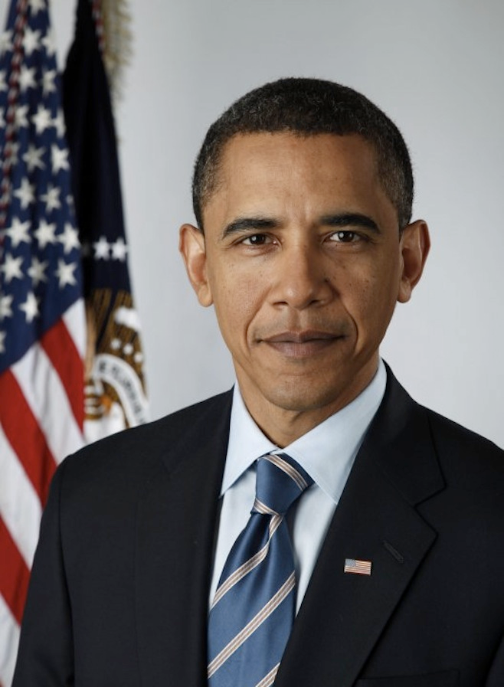
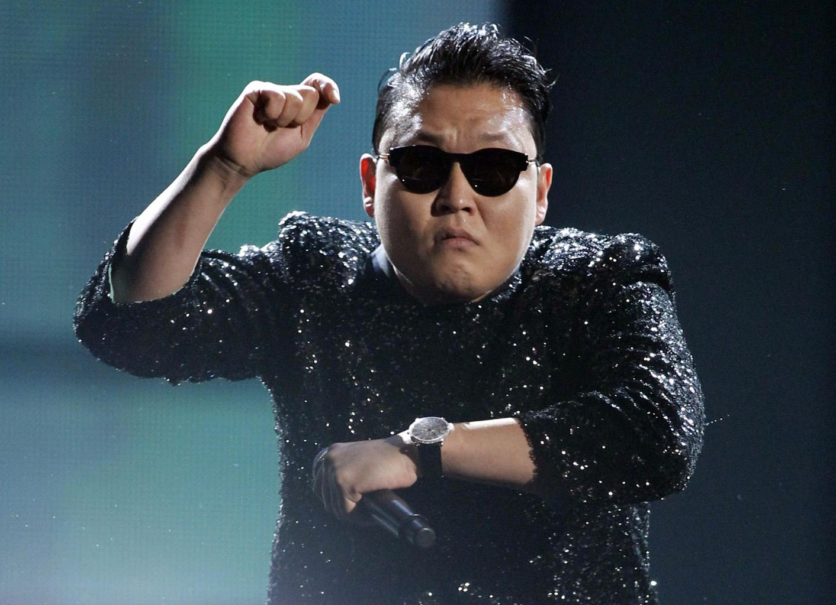
Today’s Question
Example question: who has the most friends on Facebook?
Challenges to answering this question?
It changes!
What do we need?
A snapshot of the social network graph at a particular time

Slide 4
Today’s Question
Distributed debugging
How do you debug this?
Log in to one machine and see what happens
Collect logs and see what happens
Taking a global snapshot!
P0
P1
P2
Both waiting…
Deadlock!

Slide 5
What Do We Want?
A “cut”
e₁⁰
e₁¹
e₁²
e₁³
P1
e₂¹
P2
e₂⁰
e₂²
P3
e₃⁰
e₃¹
e₃²
Would you say this is a good snapshot?
No because e₂¹ might have been caused by e₃¹.
Three things we want.
Per-process state
Messages in flight
All events that happened before each event in the snapshot

Slide 6
Obvious First Try
Synchronize clocks of all processes
Ask all processes to record their states at known time t
Problems?
Time synchronization possible only approximately
Another issue?
Does not record the state of messages in the channels
Again: synchronization not required – causality is enough!
What we need: logical global snapshot
The state of each process
Messages in transit in all communication channels
P0
P1
P2
msg

Slide 7
How to Do It? Definitions
e₁⁰
e₁¹
e₁²
e₁³
P1
e₂¹
P2
e₂⁰
e₂²
P3
e₃⁰
e₃¹
e₃²
For a process P_{i} , where events e_{i}⁰, e_{i}¹, … occur,
history(P_{i}) = h_{i} = <e_{i}⁰, e_{i}¹, … >
prefix history(P_{i}^{k}) = h_{i}^{k} = <e_{i}⁰, e_{i}¹, …,e_{i}^{k} >
S_{i}^{k} : P_{i} ’s state immediately after k^{th} event
For a set of processes P₁ , …,P_{i} , …. :
Global history: H = ∪_{i} (h_{i})
Global state: S = ∪_{i} (S_{i}^{k}i)
A cut C ⊆ H = h₁^{c1} ∪ h₂^{c2} ∪ … ∪ h_{n}^{cn}
The frontier of C = {e_{i}^{ci}, i = 1,2, … n}

Slide 8

Consistent States
A cut C is consistent if and only if
∀_{e ∈ C} (if f → e then f ∈ C)
A global state S is consistent if and only if
it corresponds to a consistent cut
e₁⁰
e₁¹
e₁²
e₁³
P1
e₂¹
P2
e₂⁰
e₂²
P3
e₃⁰
e₃¹
e₃²
Inconsistent cut
Consistent cut

Slide 9
Why Consistent States?
#1: For each event, you can trace back the causality.
#2: Back to the state machine (from the last lecture)
The execution of a distributed system as a series of transitions between global states: S0 → S1 → S2 → …
…where each transition happens with one single action from a process (i.e., local process event, send, and receive)
Each state (S0, S1, S2, …) is a consistent state.

Slide 10
CSE 486/586 Administrivia
PA2 is out.
Please start from the content provider.
Amazon EC2 is ready.
I will send out instructions regarding this soon.
We will give you two codes, $50/code.

Slide 11
The “Snapshot” Algorithm
Assumptions:
There is a communication channel between each pair of processes (@each process: N-1 in and N-1 out)
Communication channels are unidirectional and FIFO-ordered
No failure, all messages arrive intact, exactly once
Any process may initiate the snapshot
Snapshot does not interfere with normal execution
Each process is able to record its state and the state of its incoming channels (no central collection)

Slide 12
The “Snapshot” Algorithm
Goal: records a set of process and channel states such that the combination is a consistent global state.
Two questions:
#1: When to take a local snapshot at each process so that the collection of them can form a consistent global state?
#2: When to capture messages in flight sent before each local snapshot?
Brief answer for #1
The initiator broadcasts a “marker” message to everyone else (“hey, take a local snapshot now”)
Brief answer for #2
If a process receives a marker for the first time, it takes a local snapshot, starts recording all incoming messages, and broadcasts a marker again to everyone else. (“hey, I’ve sent all my messages before my local snapshot to you, so stop recording my messages.”)
A process stops recording, when it receives a marker for each channel.

Slide 13
The “Snapshot” Algorithm
Basic idea: marker broadcast & recording
The initiator broadcasts a “marker” message to everyone else (“hey, take a local snapshot now”)
If a process receives a marker for the first time, it takes a local snapshot, starts recording all incoming messages, and broadcasts a marker again to everyone else. (“hey, I’ve sent all my messages before my local snapshot to you, so stop recording my messages.”)
A process stops recording for each channel, when it receives a marker for that channel.
P1
M
M
M
M
a
P2
M
M
b
P3

Slide 14
The “Snapshot” Algorithm
1. Marker sending rule for initiator process P₀
After P₀ has recorded its own state
for each outgoing channel C, send a marker message on C
2. Marker receiving rule for a process P_{k}
on receipt of a marker over channel C
if P_{k} has not yet recorded its own state
record P_{k}’s own state
record the state of C as “empty”
for each outgoing channel C, send a marker on C
turn on recording of messages over other incoming channels
else
record the state of C as all the messages received over C since P_{k} saved its own state; stop recording state of C

Slide 15
Chandy and Lamport’s Snapshot
Marker receiving rule for process p_{i}
On p_{i}’s receipt of a marker message over channel c:
if (p_{i} has not yet recorded its state) it
records its process state now;
records the state of c as the empty set;
turns on recording of messages arriving over other incoming channels;
else
p_{i} records the state of c as the set of messages it has received over c
since it saved its state.
end if
Marker sending rule for process p_{i}
After p_{i} has recorded its state, for each outgoing channel c:
p_{i} sends one marker message over c
(before it sends any other message over c).

Slide 16
Exercise
e₁⁰
e₁^{1,2}
e₁³
e₁⁴
e₁³
P1
M
M
a
M
e₂³
e₂⁴
M
P2
e₂⁰
e₂^{1,2,3}
M
M
b
P3
e₃⁰
e₃^{2,3,4}
e₃¹
1- P1 initiates snapshot: records its state (S1); sends Markers to P2 & P3; turns on recording for channels C21 and C31
2- P2 receives Marker over C12, records its state (S2), sets state(C12) = {} sends Marker to P1 & P3; turns on recording for channel C32
3- P1 receives Marker over C21, sets state(C21) = {a}
4- P3 receives Marker over C13, records its state (S3), sets state(C13) = {} sends Marker to P1 & P2; turns on recording for channel C23
5- P2 receives Marker over C32, sets state(C32) = {b}
6- P3 receives Marker over C23, sets state(C23) = {}
7- P1 receives Marker over C31, sets state(C31) = {}

Slide 17
One Provable Property
The snapshot algorithm gives a consistent cut
Meaning,
Suppose e_{i} is an event in P_{i}, and e_{j} is an event in P_{j}
If e_{i} → e_{j}, and e_{j} is in the cut, then e_{i} is also in the cut.
Proof sketch: proof by contradiction
Suppose e_{j} is in the cut, but e_{i} is not.
Since e_{i} → e_{j,} there must be a sequence M of messages that leads to the relation.
Since e_{i} is not in the cut (our assumption), a marker should’ve been sent before e_{i}, and also before all of M.
Then P_{j} must’ve recorded a state before e_{j}, meaning, e_{j} is not in the cut. (Contradiction)

Slide 18
Another Provable Property
Can we evaluate a stable predicate?
Predicate: a function: (a global state) → {true, false}
Stable predicate: once it’s true, it stays true the rest of the execution, e.g., a deadlock.
A stable predicate that is true in S-snap must also be true in S-final
S-snap: the recorded global state
S-final: the global state immediately after the final state-recording action.
Proof sketch
The necessity for a proof: S-snap is a snapshot that may or may not correspond to a snapshot from the real execution.
Strategy: prove that it’s part of what could have happened.
Take the actual execution as a linearization
Re-order the events to get another linearization that passes through S-snap.

Slide 19
Related Properties
Liveness (of a predicate): guarantee that something good will happen eventually
For any linearization starting from the initial state, there is a reachable state where the predicate becomes true.
“Guarantee of termination” is a liveness property
Safety (of a predicate): guarantee that something bad will never happen
For any state reachable from the initial state, the predicate is false.
Deadlock avoidance algorithms provide safety
Liveness and safety are used in many other CS contexts.

Slide 20
Summary
Global states
A union of all process states
Consistent global state vs. inconsistent global state
The “snapshot” algorithm
Take a snapshot of the local state
Broadcast a “marker” msg to tell other processes to record
Start recording all msgs coming in for each channel until receiving a “marker”
Outcome: a consistent global state

Slide 21
Acknowledgements
These slides contain material developed and copyrighted by Indranil Gupta at UIUC.

